Slide 1
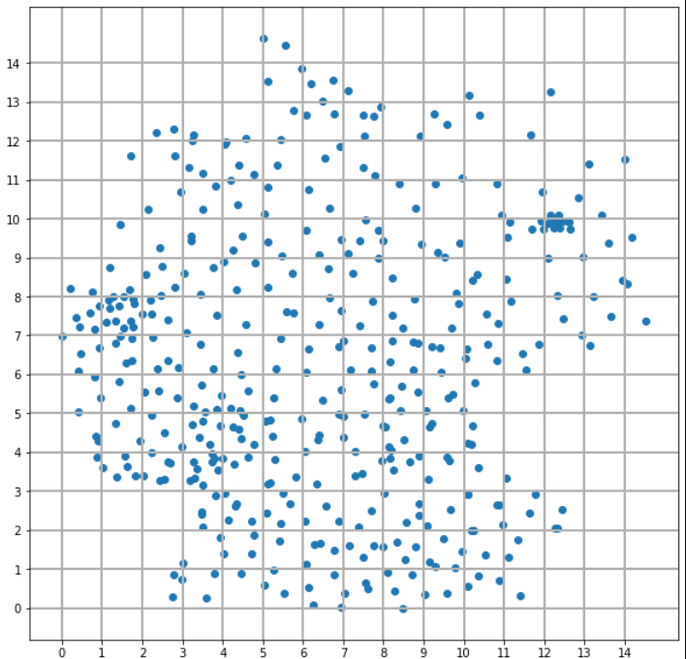

Slide 2
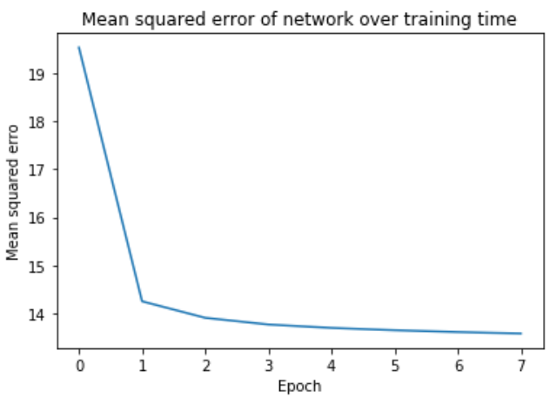
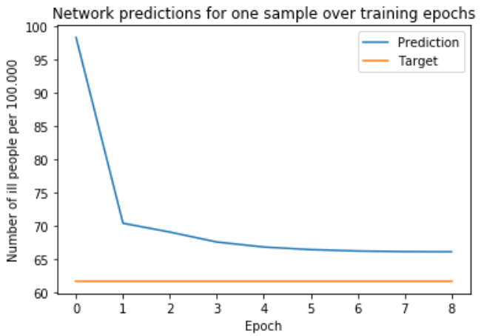

Slide 3
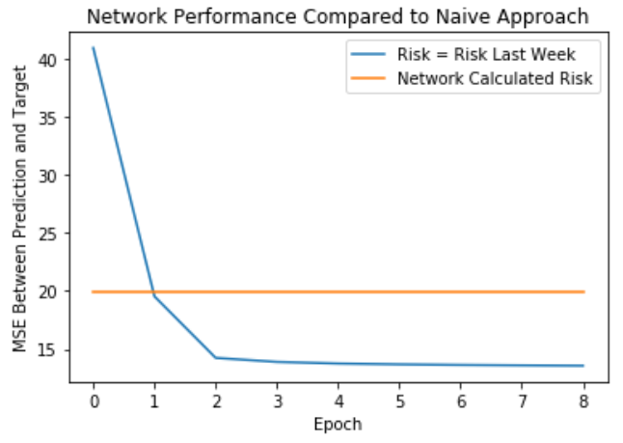

Slide 4
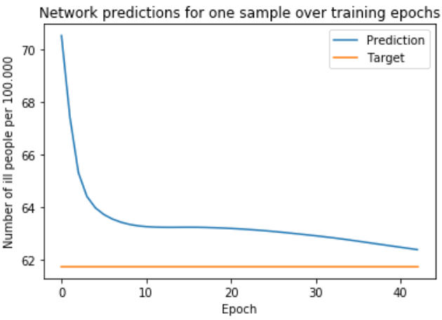
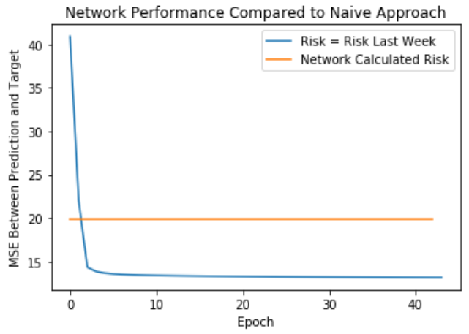
Now both networks combined:

Slide 5
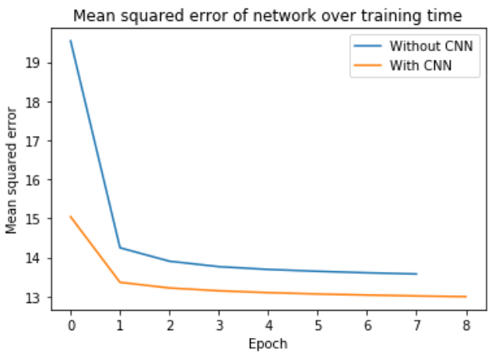

Slide 6
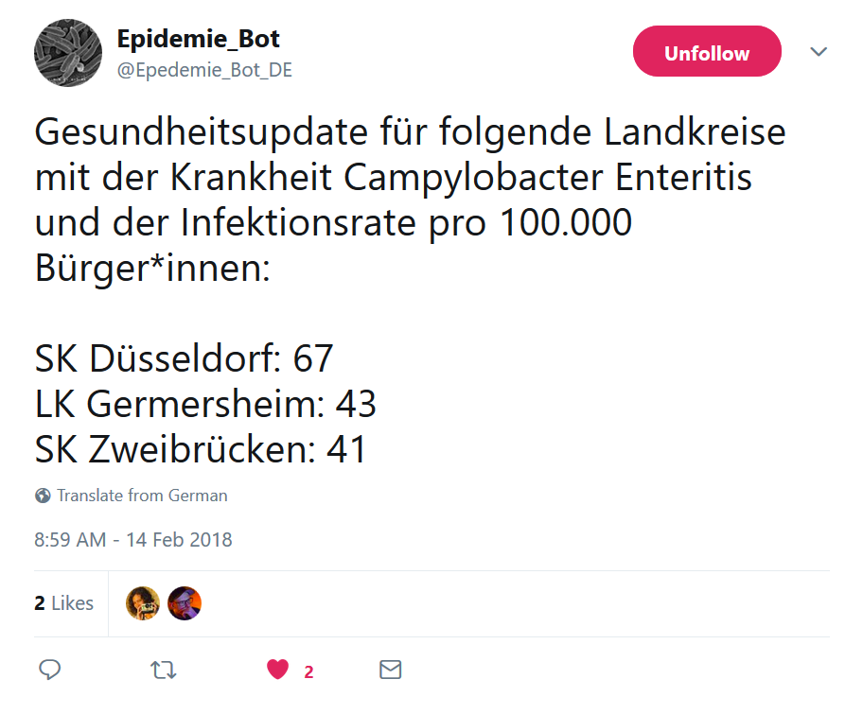
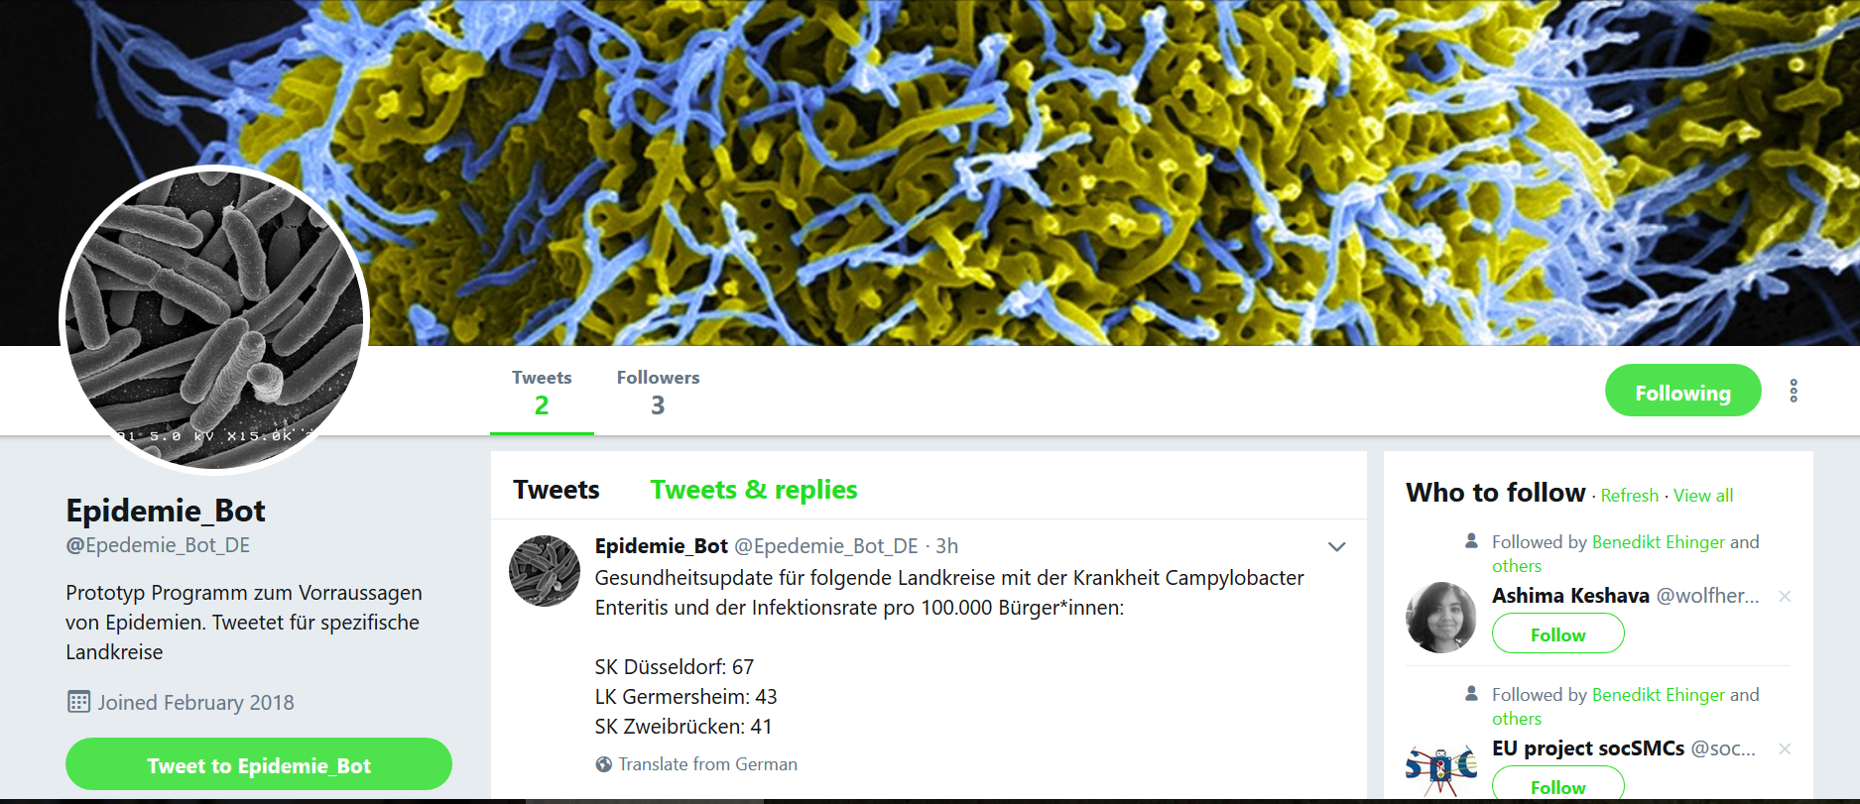

Slide 7

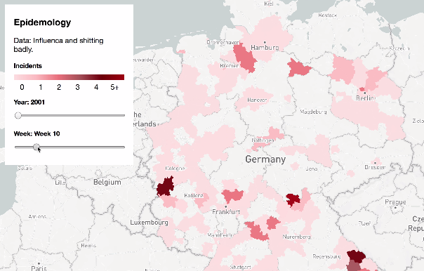




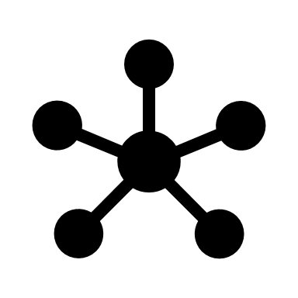




Future Research
Local Risk Alerts
Personal Risk
Robert Koch Institute
Artificial Neural Networks
Real Time Data
Ask about areas of risk
Archived health Data
Provide own symptoms
Provides diagnosis
Doctor
Visits doctor

Slide 8
Future Research
Local Risk Alerts
Personal Risk
Robert Koch Institute
Artificial Neural Networks
Real Time Data
Ask about areas of risk
Archived health Data
Provide own symptoms
Provides diagnosis
Doctor
Visits doctor

Slide 9
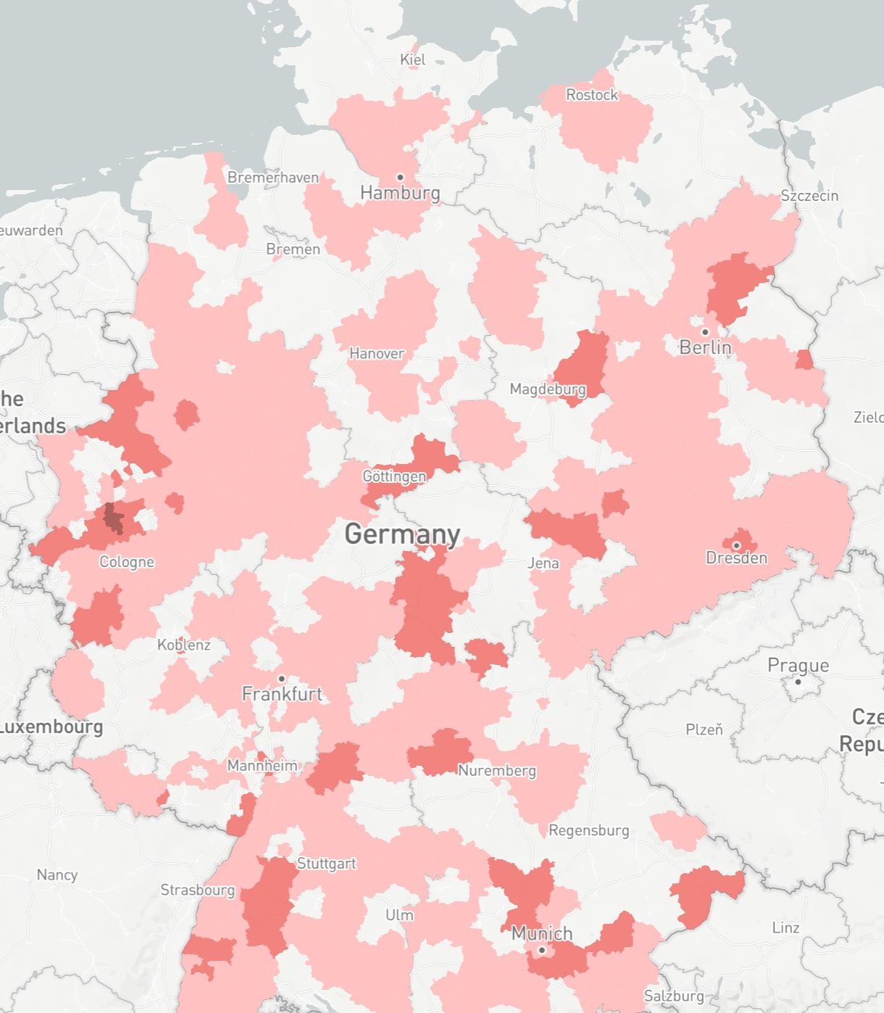
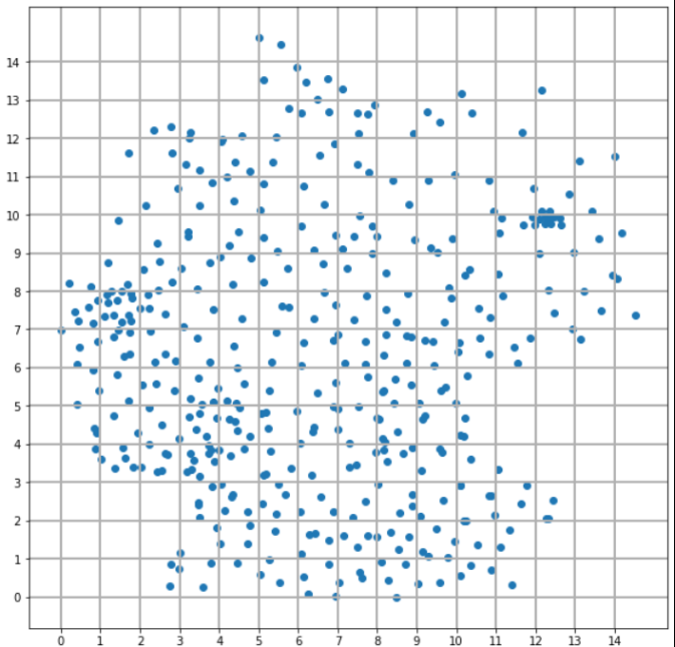
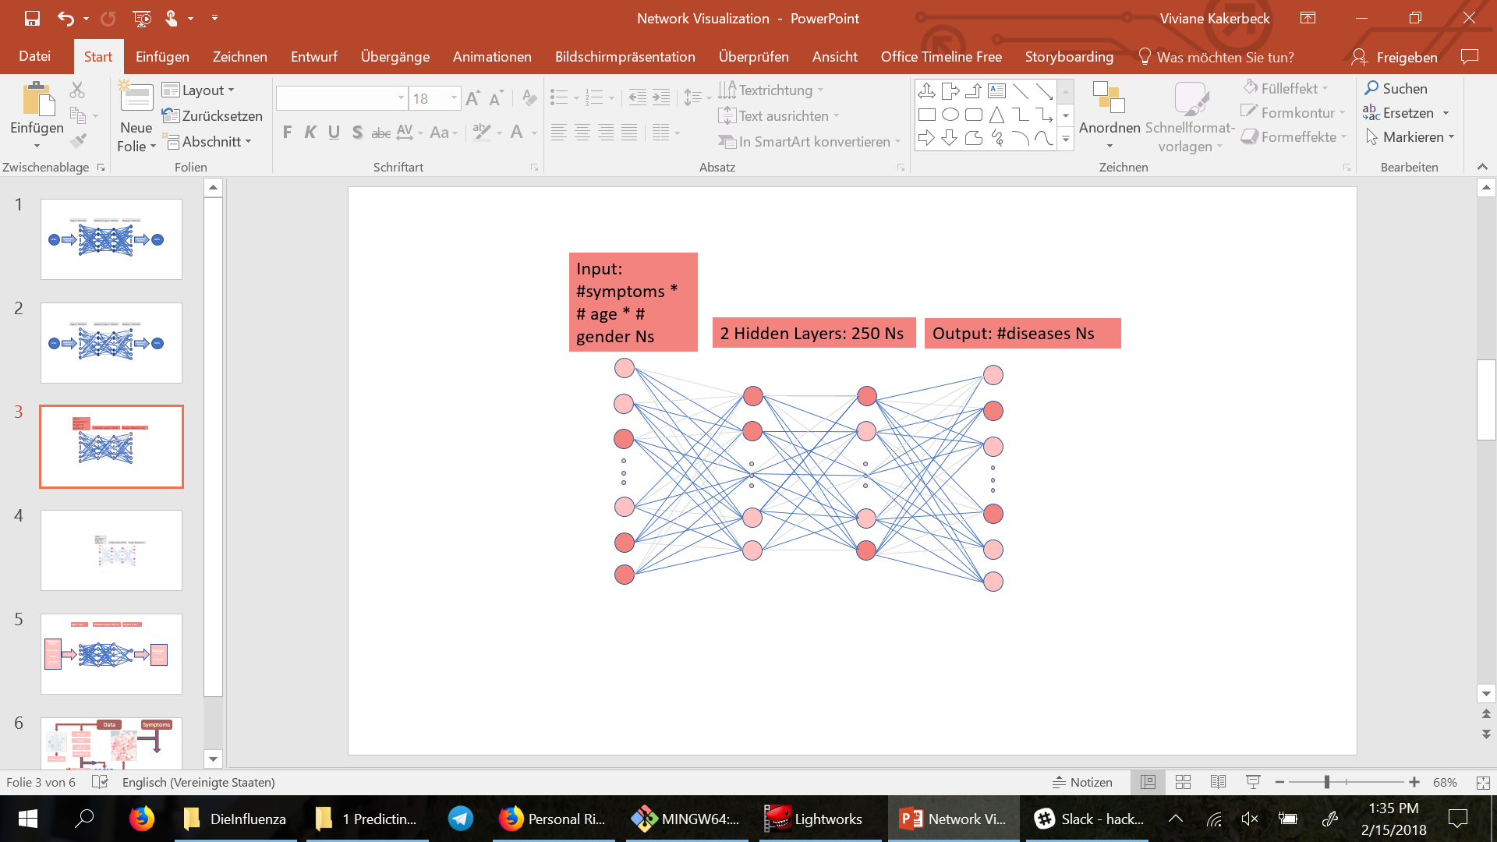
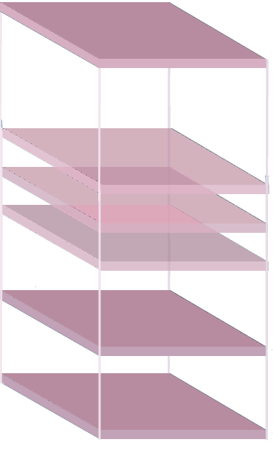
Data
Symptoms
GPS (X,Y)
Week
Count - LK
Incidence – LK
Incidence – Bin
Incidence Prediction Bin
Count – LK
Next week
Incidence – LK
Next week
Personal Risk for Diseases
CNN
FFN
FFN 2

Slide 10
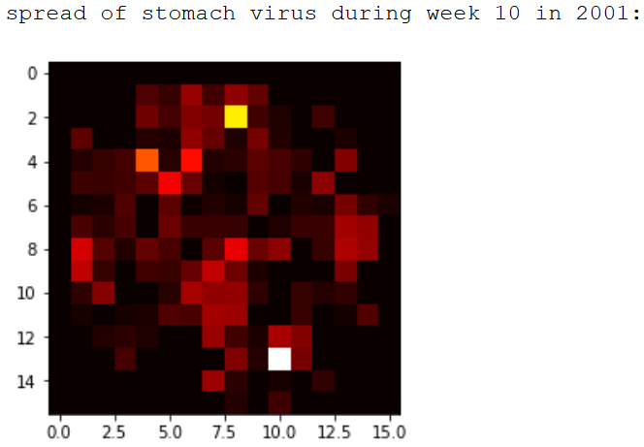

Slide 11
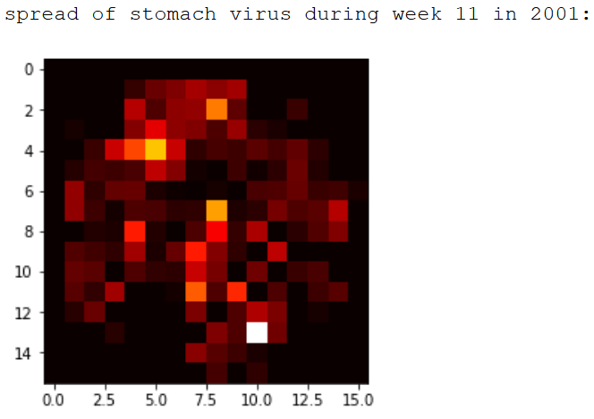

Slide 12
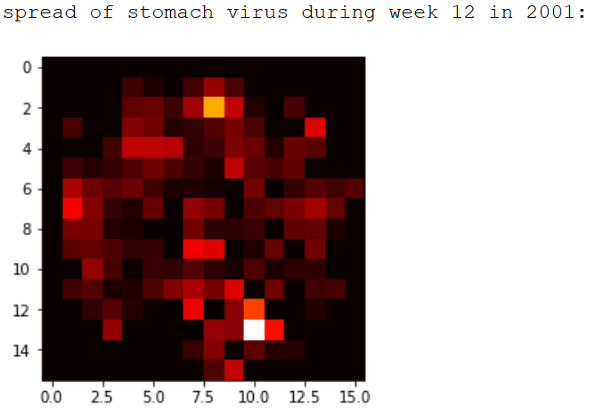

Slide 13
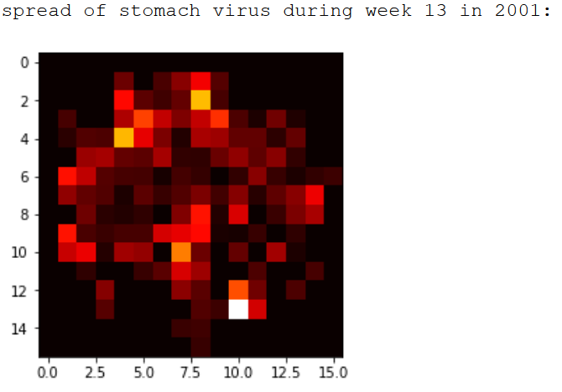

Slide 14
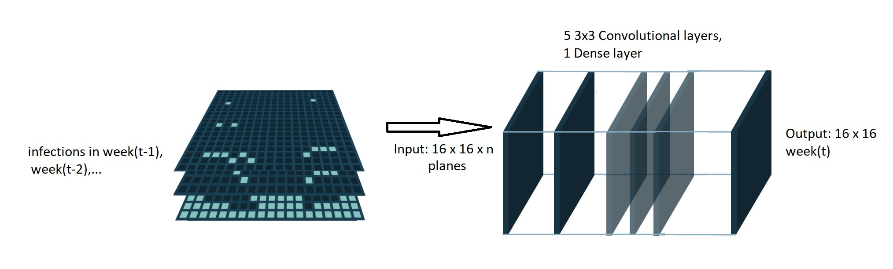
CNN Network Structure

Slide 15
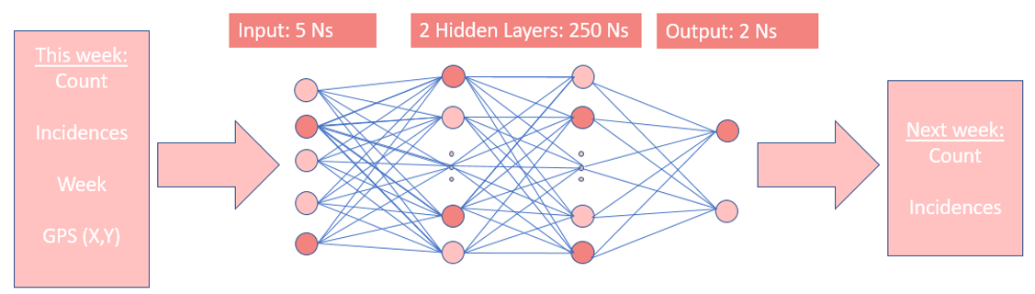
FFN Network Structure

Slide 16
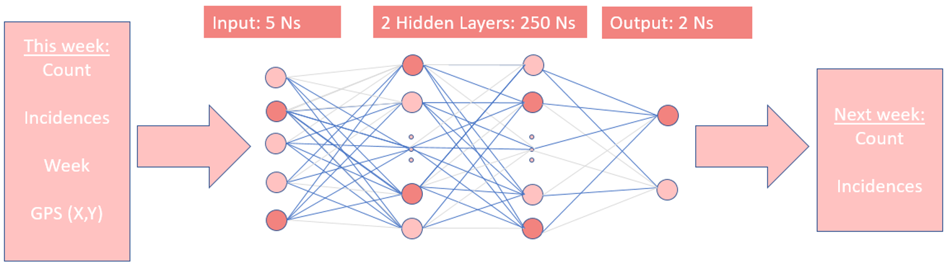
FFN Network Structure

Slide 17
Network Performance

Slide 18
Network Performance

Slide 19
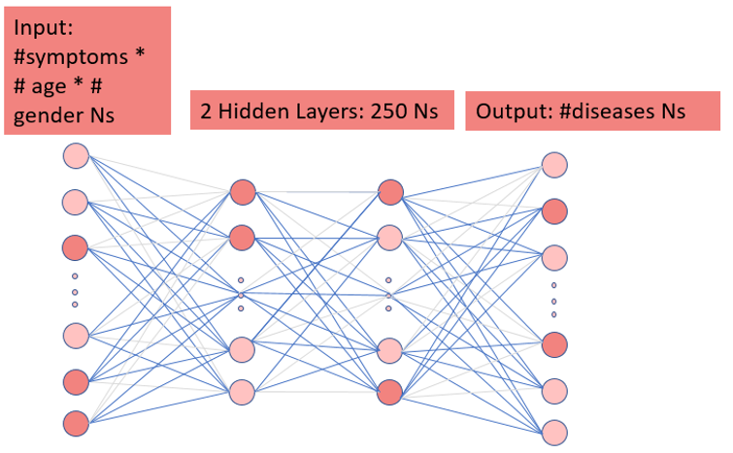
Symptom Network Structure (FFN)
Symptoms
Age
Gender
Probability for each disease

Slide 20
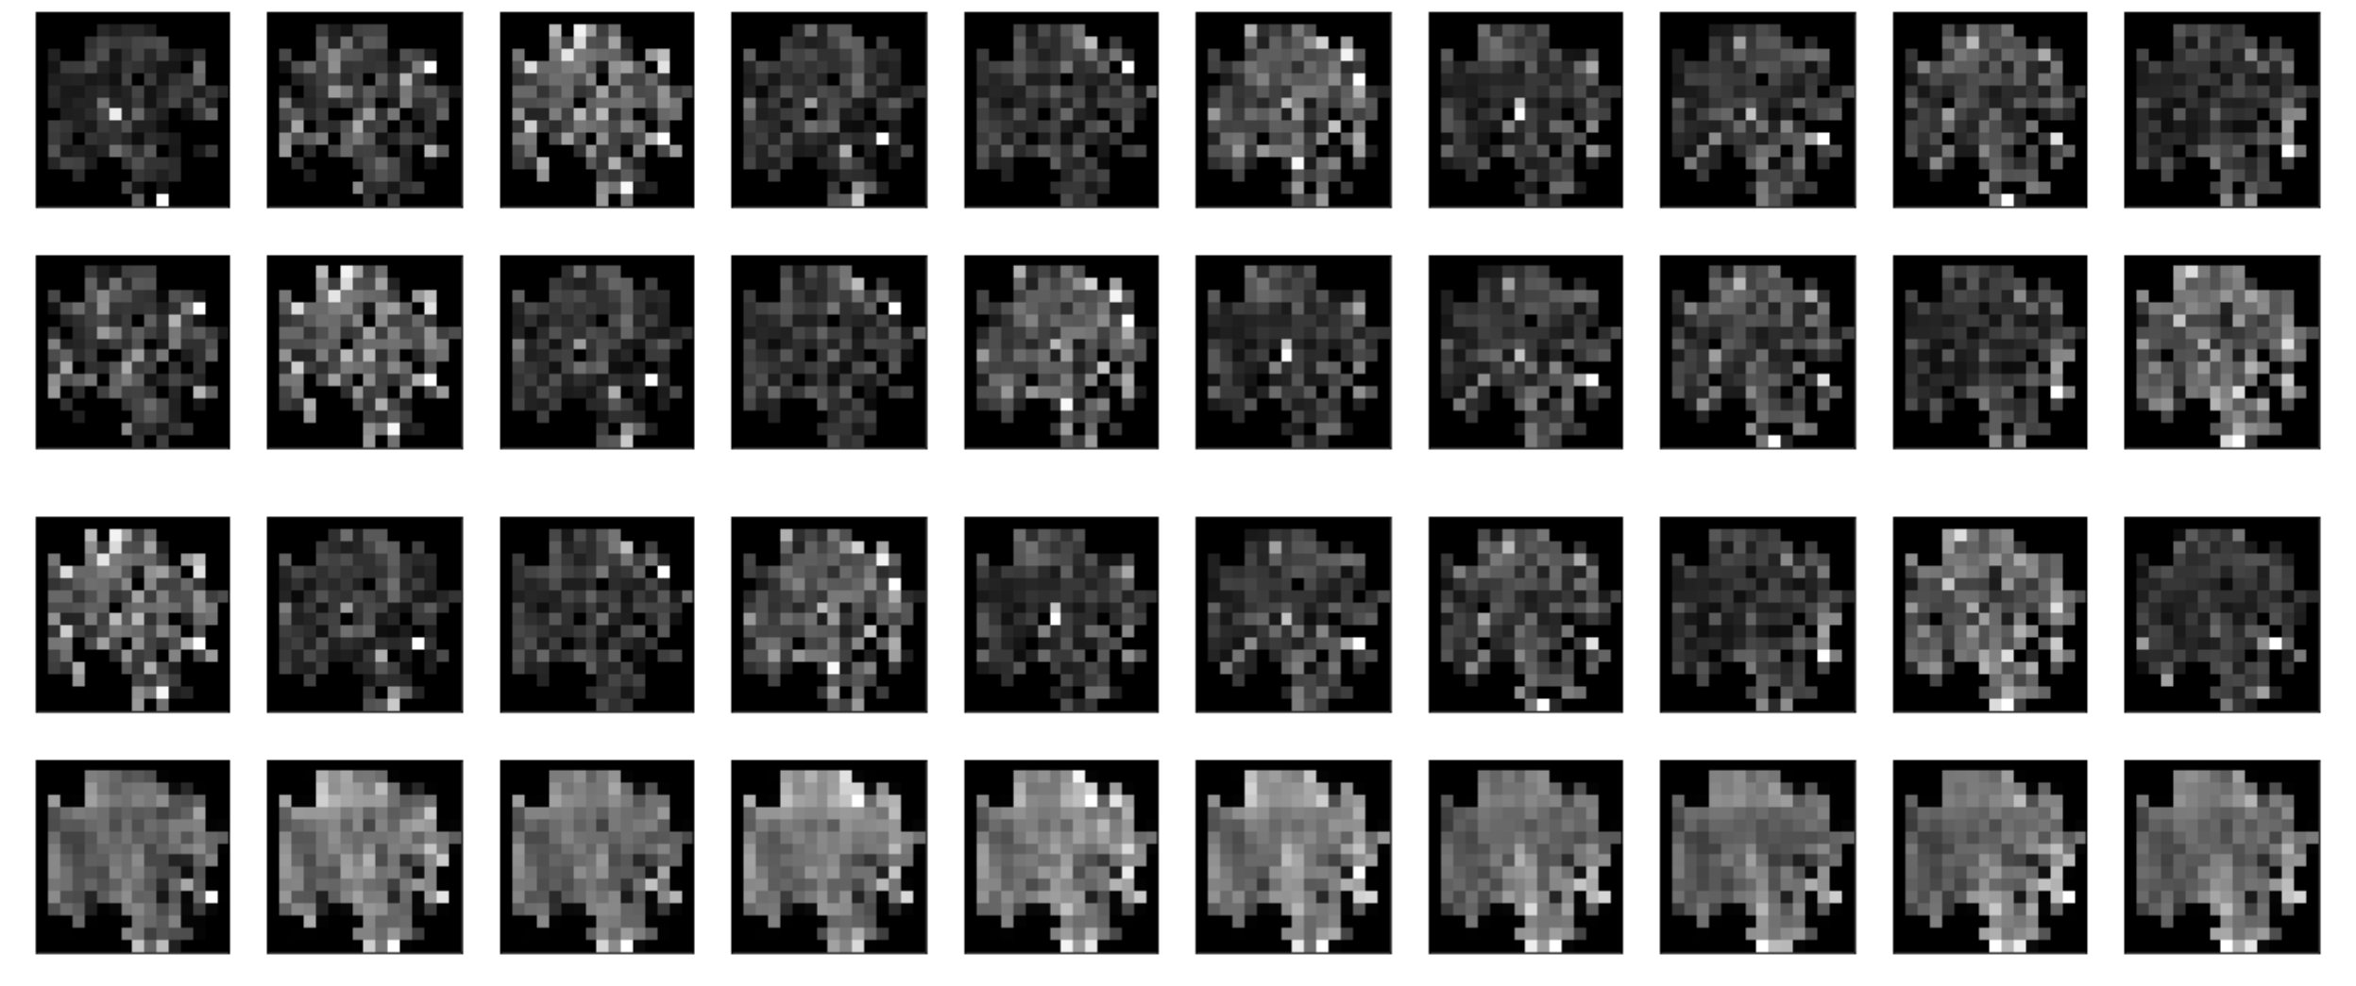
Discussion - CNN

Slide 21
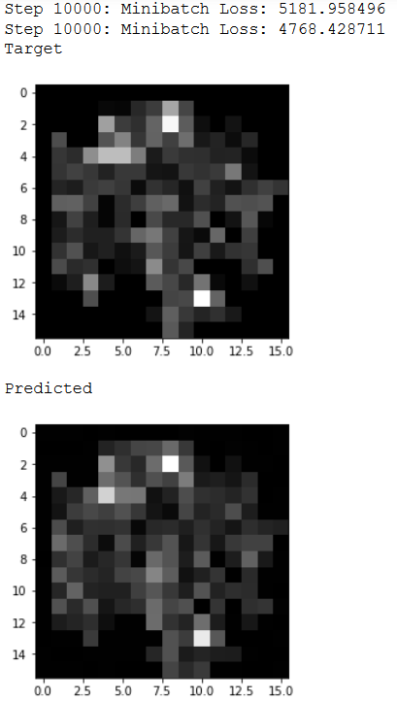
Discussion – Auto Encoder (CNN Alternative)

Slide 22
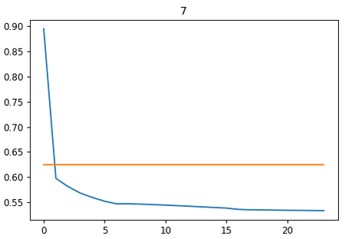
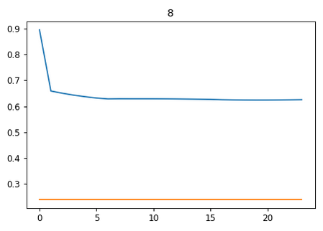
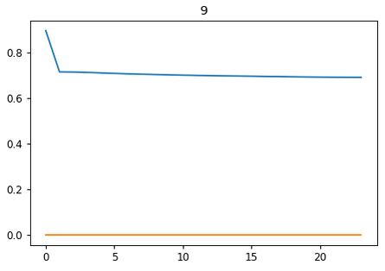
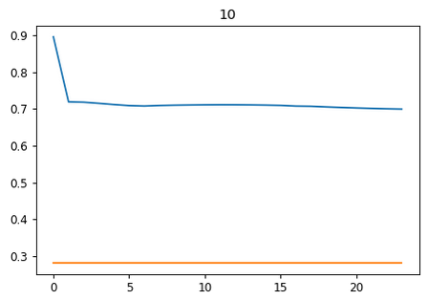
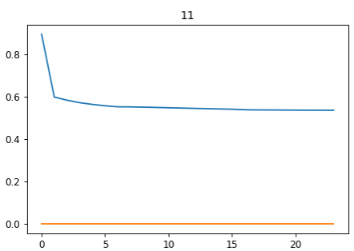
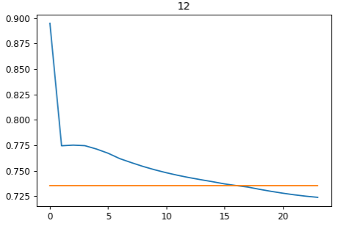
Discussion – FFN

Slide 23
Outlook
Add more diseases
Finish personal risk prediction
Determine factorization of location vs. symptoms (learn with network or empirical data?)
Hyperparameter search (eg. Resolution of CNN)
Incorporate into phone application
Validation by doctors?
Add more data (eg: weather, more cross over between networks, more previous data for FFN)
Possibility of real time updates of network

